Slide 1

School Funding and Property Taxes 101
Kearsarge Regional School District
June 19, 2019
Andru Volinsky (andruvolinsky@gmail.com)
and John Tobin (jtobinjr@comcast.net)

Slide 2
School Funding in 2019 – Is the State meeting the NH Constitution’s two core requirements for K-12 public education?
The State has a duty to pay for the cost of a constitutionally adequate education for every K-12 public school student;
The taxes that the State uses to pay for this education must have a uniform rate across the state.

Slide 3
A Constitutionally Adequate Education –
A Broad Standard
“Given the complexities of our society today, the State's constitutional duty extends beyond mere reading, writing and arithmetic. It also includes broad educational opportunities needed in today's society to prepare citizens for their role as participants and as potential competitors in today's marketplace of ideas.”
(Claremont I)
138 N.H. 183, 192 (1993)

Slide 4
School Tax is Unjust
Claremont School Distr. V. Gov., 142 N.H. 462, 703 A.2d 1353 (1997) (Claremont II) (4-1).
“…the present system of financing elementary and secondary public education in New Hampshire is unconstitutional. To hold otherwise would be to effectively conclude that it is reasonable, in discharging a State obligation, to tax property owners in one town or city as much as four times the amount taxed to others similarly situated in other towns or cities…precisely the kind of taxation and fiscal mischief from which the framers…took strong steps to protect our citizens.” 142 N.H. at 465.

Slide 5
A New Court Decision on School Funding:
The ConVal Case
“The Court construes the fundamental right at issue as a right to the opportunity to a fully State-funded adequate education.” [emphasis added]
Cheshire County Superior Court
Justice David Ruoff
June 5, 2019

Slide 6
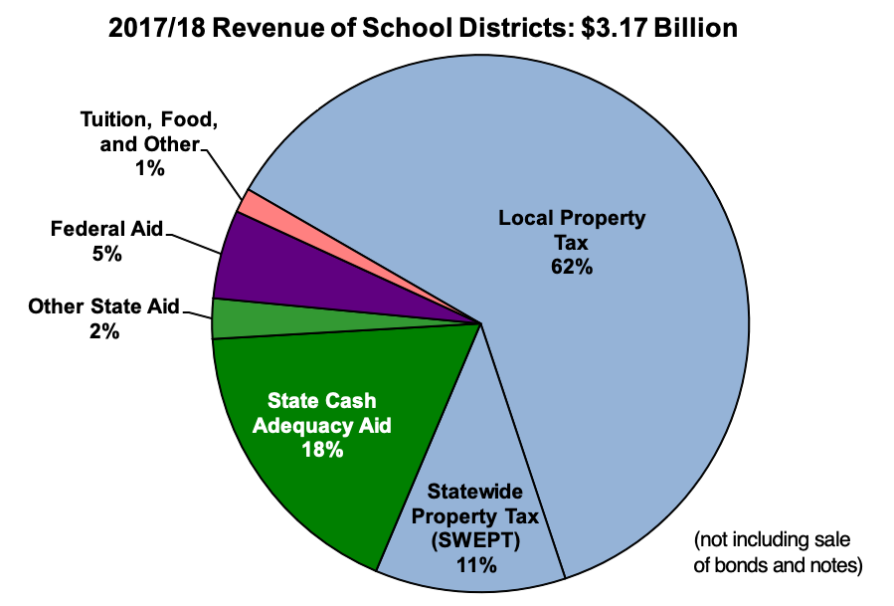

Slide 7
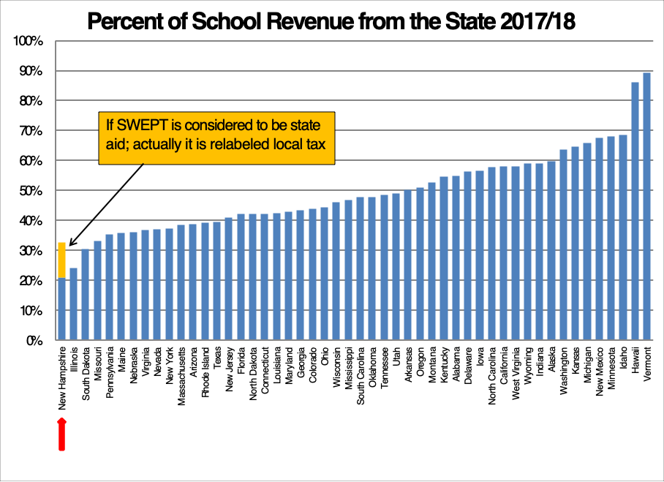

Slide 8
The core concept
Eq Val/pupil
How much property value is available in a town to be taxed
to support each student’s education?

Slide 9
It’s a simple math problem!
Property Tax Funds
Value Rate Raised
  $20 x 2 = $40
  $4 x 2 = $8

Slide 10
Unequal Tax Burdens
In Paying for the Same Expense
Total
Property Value Expenditure Tax Rate
Town A
$1,000 $100 10%
Town B
$5,000 $100 2%

Slide 12
Representative 2017 -2018
Equalized Values Per Pupil
District Eq. Val/ Pupil Enrollment
Berlin $325,535 1,077 students
Claremont $405,976 1,729 students
Concord $900,409 4,287 students
Derry $632,071 5,077 students
Hopkinton $739,329 949 students
Kearsarge Region. $1,773,982* 1,762 students
Manchester $724,178 13,968 students
Moultonborough $6,731,382 473 students
Pittsfield $469,334 586 students
Portsmouth $2,630,274 2,205 students
State Average $1,043,647 *District average

Slide 13
Local + State Educ. Equalized Tax Rates 2017-18 and Tax Bill for a $200,000 Home
State Average $12.70 $2,540
State Median $14.69 $2,938
Berlin $18.82 $3,764
Claremont $24.82* $4,964
Concord $13.28 $2,656
Derry $16.94 $3,388
Hopkinton $21.18 $4,236
Manchester $9.85** $1,970
Moultonborough $4.06 $812
New London $8.42 $1,684
Pittsfield $19.83 $3,966
Portsmouth $6.60 $1,320
Warner $16.33 $3,266
*$42.58 overall tax rate: NH’s highest. **Tax cap in effect

Slide 14

Tax Rates v. Spending Per Pupil
District | Equalized Val/Pupil | Tax Rate | Spending/Pupil
Berlin | $325,535 | $18.82 | $16,679
Claremont | $405,976 | $24.82 | $16,475
Concord | $900,409 | $13.28 | $15,639
Derry | $632,071 | $16.94 | $15,014
Hopkinton | $739,329 | $21,18 | $17,265
Manchester | $724,178 | $9.85 | $12,024
Moultonborough | $6,731,382 | $4.06 | $25,429
New London | $4,943,042 | $8.42 | $19,122*
Pittsfield | $469,334 | $19.83 | $16,161
Portsmouth | $2,630,274 | $6.60 | $18,346
Warner | $774,894 | $16.33 | $19,122*
State Average | $1,043,647 | $12.70 | $15,835 * District-wide amt.

Slide 15
Kearsarge Regional School District
Local/State Educ. Tax Bill on $200,000 Home
(Based on 2017-2018 Equalized Tax Rates)
Equalized Equalized Taxes on
Value Education $200,000
Per Pupil Tax Rate Home
Bradford $1,090,340 $12.44 $2,488
New London $4,943,042 $8.42 $1,684
Newbury $2,366,701 $8.98 $1,796
Springfield $1,093,064 $15.77 $3,154
Sutton $1,014,523 $12.95 $2,590
Warner $774,894 $16.33 $3,266
Wilmot $1,247,745 $13.09 $2,618
State Average $1,043,647 $12.70 $2,540

Slide 16
Four School Districts: Enrollments and
Equalized Valuations per Pupil
State Average $1,043,647/pupil
State Median $978,684/pupil
Milford $685,446 (2,191 students)
Portsmouth $2,630,274 (2,205 students)
_________________________________________
Pittsfield $469,334 (587 students)
Rye $3,816,244 (597 students)

Slide 17
Four School Districts: Equalized Value Per Pupil and Equalized Educ. Tax Rate
 | Equalized Value Per Pupil | Equal. Educ. Tax Rate | Tax on $200K Home | Tax on $10M Business
Milford | $685,446 | $19.32 | $3,864 | $193,200
Portsmouth | $2,630,274 | $6.60 | $1,320 | $66,000
Pittsfield | $469,334 | $19.83 | $3,966 | $198,300
Rye | $3,816,244 | $5.84 | $1,168 | $58,400

Slide 18
Four School Districts
Eq. Value/ Pupil, Tax Rates and
Spending Per Pupil
Eq. Val/ Eq. Ed. Spending
Per Pupil Tax Rate Per Pupil
Milford $685,446 $19.32 $15,994
Portsmouth $2,630,274 $6.60 $18,346
___________________________________________________
Pittsfield $469,334 $19.89 $16,161
Rye $3,816,244 $5.84 $23,123

Slide 19
Portsmouth and Milford
District | Eq. Val/P | Tax Rate | Spending Per Pupil
Portsmouth | $2,630,274 | $6.60 | $18,346
Milford | $685,446 | $19.32 | $15,994
Portsmouth’s spending per child is $2,352 higher than Milford’s. For a classroom of 20 children, the difference is $47,040 per year. Multiplied across K-12 (13 grades), the difference is $611,520 per classroom. At the same time, Milford’s tax rate, even with much lower spending per pupil, is nearly three times higher than Portsmouth’s.

Slide 20
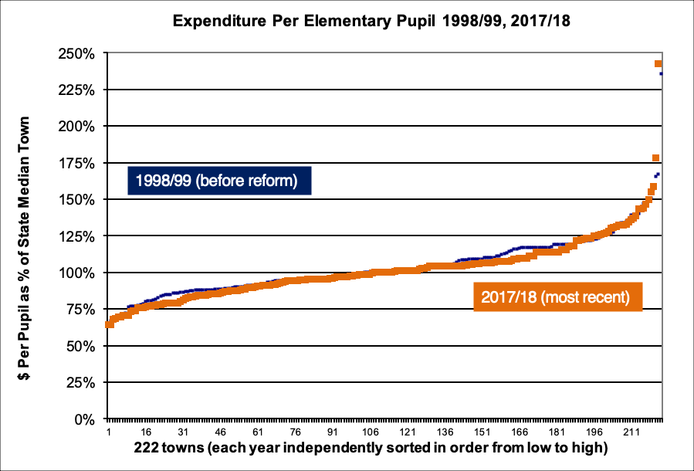

Slide 21
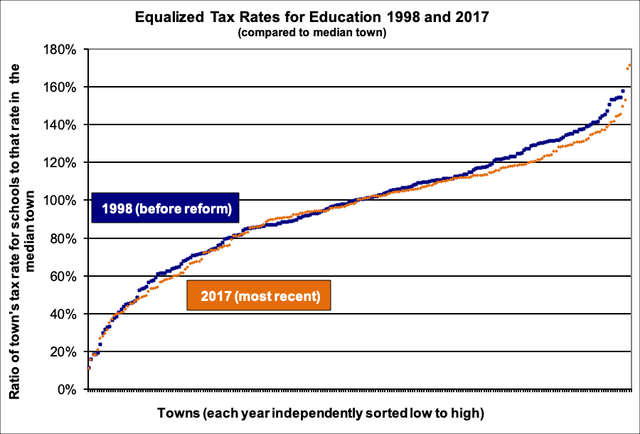

Slide 22
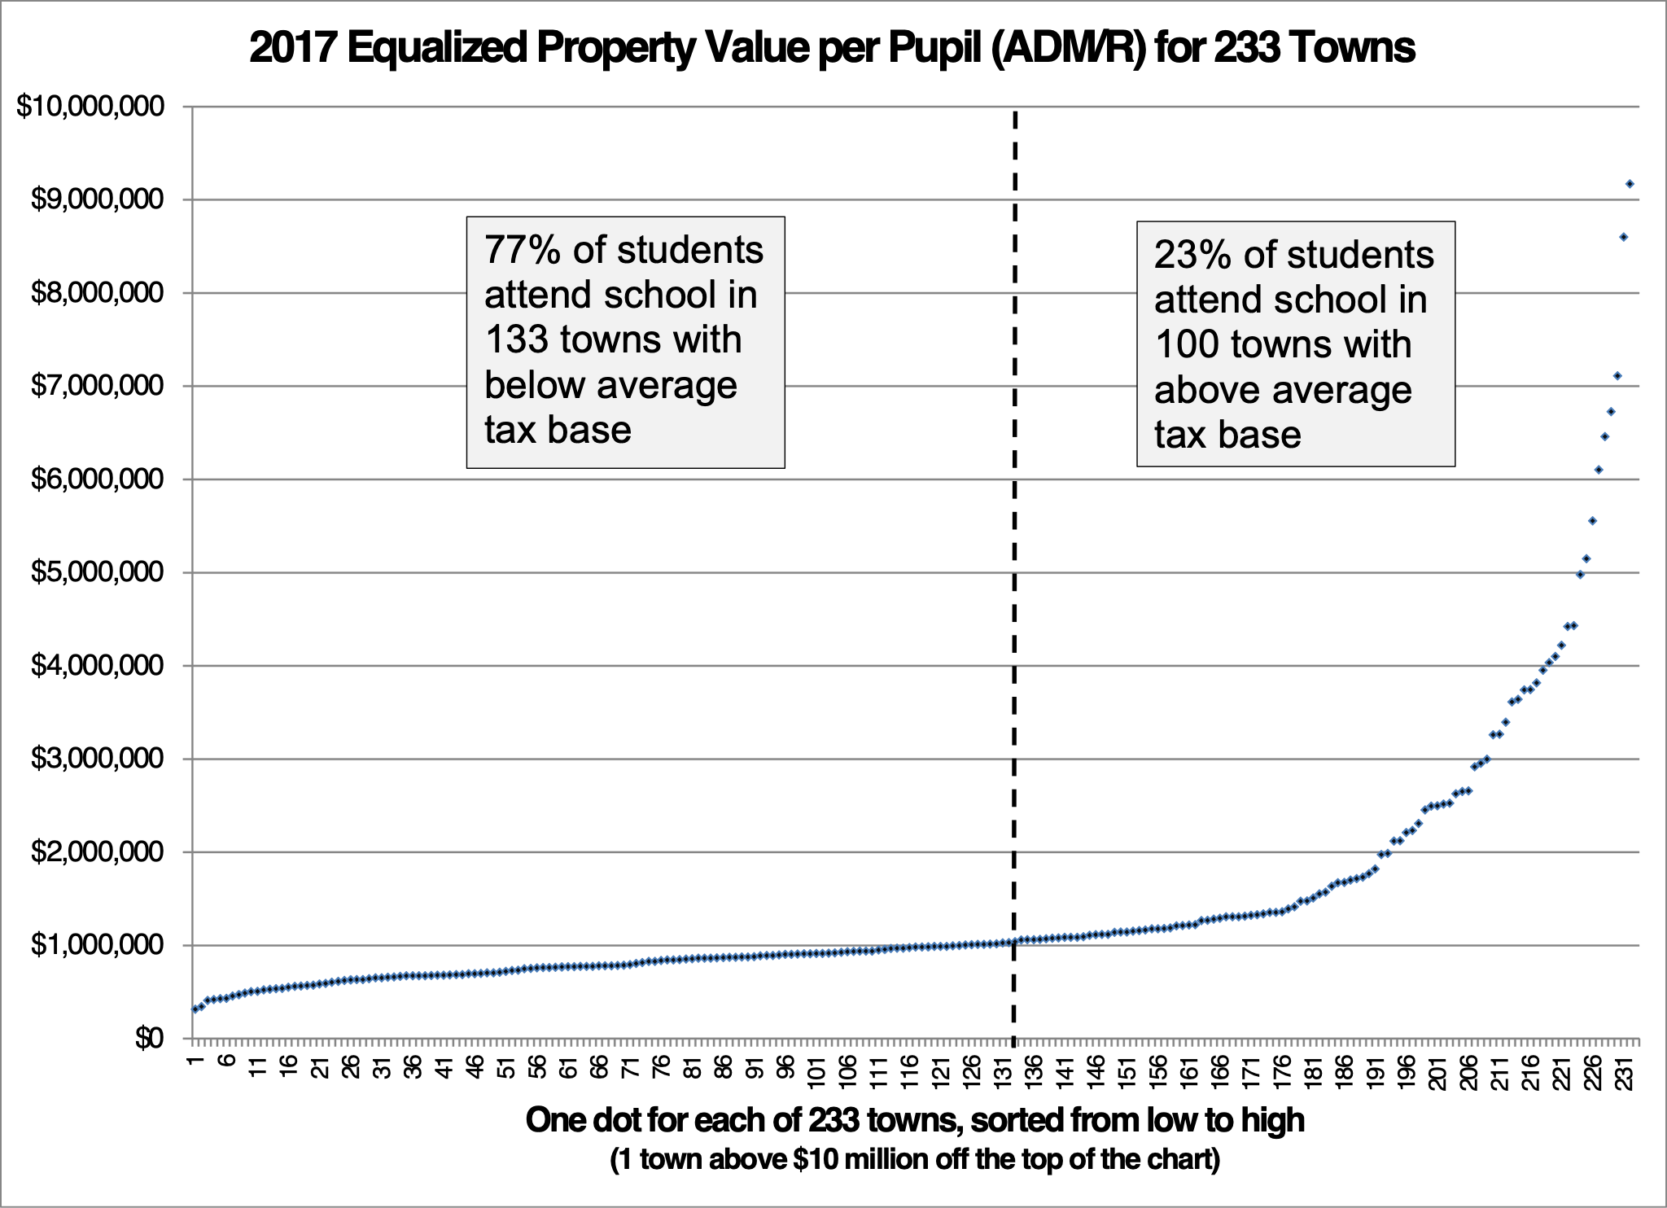
77% of Children Attend School
in Communities with Below Average
Equalized Values

Slide 23
Other Implications
Barrier to Economic Development (new businesses and business expansion)
Works Against Attracting and Keeping Young Families: Workforce Housing;
Discourages Regional Cooperation and Efficiency/Economies of Scale
Uneven Burdens of Current Use Taxation and Untaxable State/Federal Land

Slide 24
NH BUSINESS REVIEW
"The Other New Hampshire:
The State of the State’s 19 Largest ‘Property-Poor’ Communities.”
…more than half the acreage of 17 of these 19 property-poor municipalities is taxed at less than its full market value or not taxed at all. The portion of discounted or non-taxable acreage in Berlin is 87 percent…Boscawen 78 percent, in Allenstown 76 percent… in Claremont and Pittsfield 68 percent and in Bennington, Northfield and Greenville 66 percent.

Slide 25
Adequacy Aid
For FY2018 and FY2019—
Statewide Base Rate is $3,636/pupil
(with differential aid, $4,477/pupil).
In the 2017-2018 school year, the State average cost per pupil was
$15,865.

Slide 26
The ConVal Decision:
The current adequacy cost standard is unconstitutional
RSA 198-40a II(a), the state statute that sets the cost of baseline adequacy (currently $3,636), is unconstitutional as applied to the petitioner school districts.
Cheshire County Superior Court
Justice David Ruoff
June 5, 2019

Slide 27
What does an “Adequate” K-12 Education Cost ?
Let’s take an example:
The State of New Hampshire says that for Pittsfield’s 581 students it should cost
$2,690,333
The Pittsfield School District budget this year is $10,302,402
So let’s pare that budget down…..

Slide 28
Eliminate 5 of the 16 teachers at the elementary school
Eliminate all art, music, and physical education classes in all grades
Eliminate all school nurses and any medical support
Eliminate all regular and special education transportation services (parents to transport their children to and from school)
Eliminate one of the two office secretaries at the elementary school
Eliminate one of the two office secretaries at the middle/high school
Eliminate teachers for business ed, family & consumer science, and health
Eliminate one of four science teachers at the middle/high school, thus eliminating some labs and electives
Eliminate all building and grounds maintenance and repairs
Eliminate student participation in Concord Regional Technical Center classes
Eliminate all foreign language courses
Eliminate both counselor/behavioral professionals and support staff
Eliminate four of eight custodians: building cleaning only twice per week
Eliminate health insurance and other benefits in current teacher contract
Eliminate all field trips
Eliminate all athletic programs: soccer, basketball, softball, and baseball
Eliminate the district reading specialist
Eliminate 34½ paraprofessional positions, including special ed teacher aides
Eliminate purchase of equipment, supplies, books, subscriptions, technology
Eliminate ESOL program (English for speakers of other languages)

Slide 29
Eliminate all substitute teachers, thus requiring students to be dismissed
Eliminate three special education teachers
Eliminate provisions for teacher development courses, workshops
Eliminate mentor teachers who support new teachers
Eliminate all technology personnel, equipment, training, software, etc.
Eliminate consulting specialists such as vision specialists and psychologists
Eliminate travel reimbursement for training events, meetings, home visits, etc.
Eliminate all co-curricular programs (clubs, activities, student council, etc.)
Eliminate the summer recreation program
Eliminate all guidance personnel
Eliminate substance abuse counselor
Eliminate speech/language, PT, OT, and vision services for special needs students
Eliminate stipend for teachers’ summertime work on innovation and development
Eliminate stipends for teacher leaders
Eliminate all librarians and media center staff and close media centers
Eliminate school board stipends
Eliminate school board expenses, including lawyers and auditing services
Reduce time of superintendent to one day per week
Eliminate all photocopiers and their supplies
Eliminate maintenance of athletic field
Eliminate one school principal, leaving only one for both school buildings
Eliminate all office incidentals: postage, supplies, advertising, etc.

Slide 30
With the above reductions
We maintain most “core” K-12 classrooms
Class size averages 29 students/teacher
Budget is $5,289,610
Now cut to the State’s “adequacy” level of $2,690,333
Nearly everything else has been eliminated so now eliminate nearly half of the remaining teachers
Class size averages 60 students/teacher
How does anyone believe that this will provide an adequate education?

Slide 31
Comparing Starting Teacher Salaries
New graduate with a BA, first year salary
District | Salary |  | District | Salary
Portsmouth | $44,667 |  | Pittsfield | $30,452
Stratham | $45,060 |  | Franklin | $32,782
Hanover | $45,167 |  | Stratford | $32,800
Exeter | $45,462 |  | Allenstown | $34,331
Lyme | $47,365 |  | Newport | $34,363
New graduate with an MA, first year salary
District | Salary |  | District | Salary
Hanover | $50,135 |  | Stratford | $34,300
Lyme | $51,391 |  | Pittsfield | $34,323
Portsmouth | $51,604 |  | Franklin | $35,904
Exeter | $51,736 |  | Newport | $36,517
Stratham | $51,917 |  | Allenstown | $39,736
Bottom line: starting teachers in Pittsfield might earn $15,000 more elsewhere

Slide 32
SAT Scores of High School Juniors, 2018

Slide 33
SWEPT
StateWide Education Property Tax
Target: $363 million out of $3.2 billion.
Municipalities collect the SWEPT and send the total amounts collected directly to their own school districts. The SWEPT money is never transferred to the state. The SWEPT does not reduce disparities among school districts.
Average SWEPT tax rate was $2.17 for 2016-17. For 2017-18 it is $2.06.

Slide 34
Stabilization Grants
(a lifeline being withdrawn)
Stabilization Grant:
Enacted for FY2012 to replace Disparity Aid calculation which was part of adequacy
Removed $160 million from Adequacy Aid
Stabilization reduced at the rate of 4% per year since FY2017. For FY2019, the stabilization grant will be 88% of the 2012 amount
Berlin loses $219,824/year
  In Berlin, it takes $0.55 to make up for this loss each year. Berlin’s school tax rate will increase by $13.75/1000, all other things remaining equal, just to replace the loss of stabilization aid over 25 years.

Slide 35
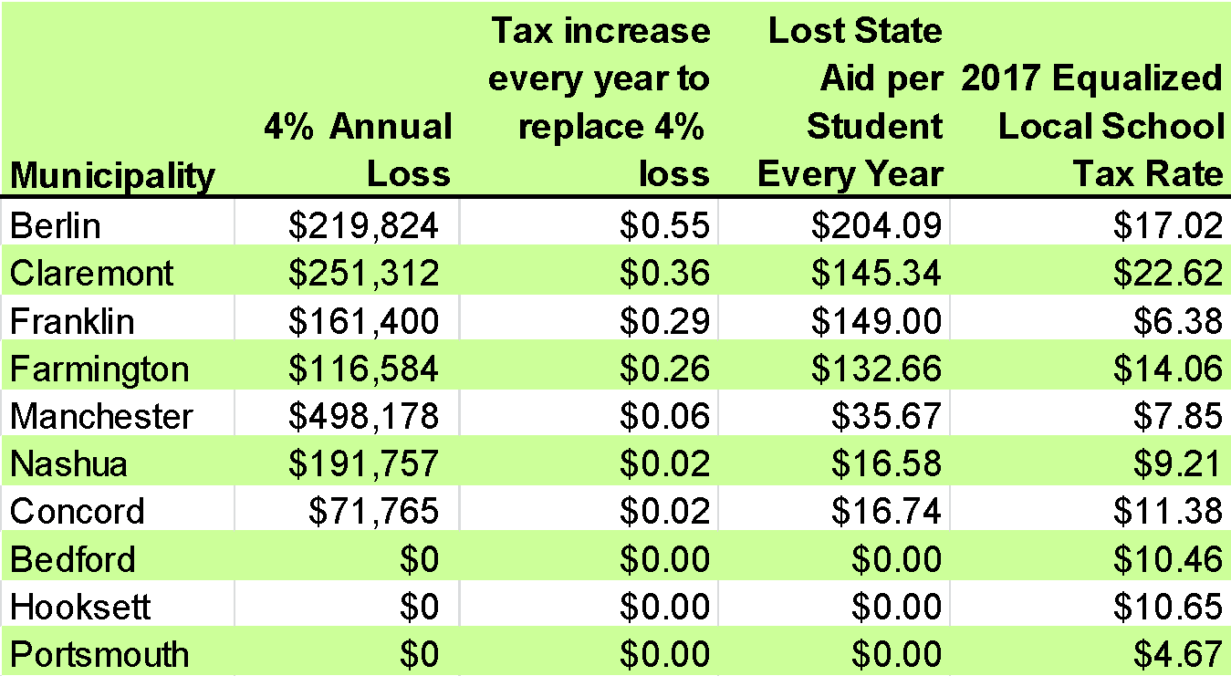
Examples of Annual Stabilization Losses

Slide 36
Building Aid
(doesn’t exist any longer--was once an incentive for districts to combine)
$54,353,188.20-distributed in 2008-09

Slide 37
NHLottery
$1.7 billion to education
FY2017
Total Oper. Revenue $304,221,428
Total Expenses $228,167,737
Distributed to Education $76,119,818
That’s just over $76 million contributed last FY. Total spending on education in NH was more than $3.1 billion, meaning NH Lottery accounts for 2.5% of school funding.

Slide 38
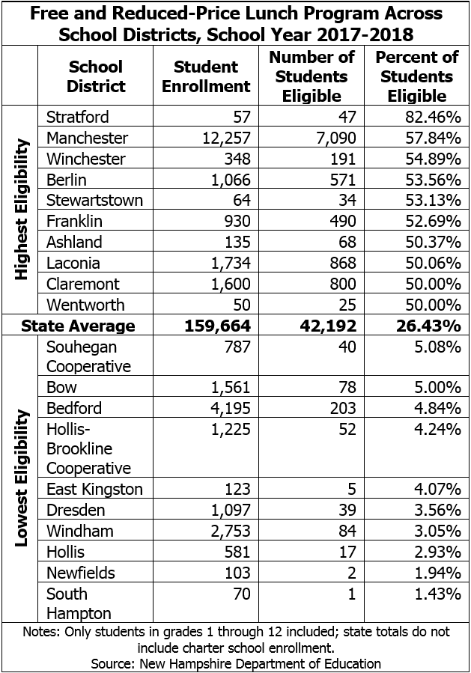


Slide 39
Goals for 2019 Legislative Session
Immediate – Restore “Stabilization Aid” to the poorest districts to 2012 levels. Passed House 250-96. This would be effective on July 1, 2019.
Medium Term – Provide new Disparity Aid on July 1, 2020. Passed House 262-82.
Long Term – Establish an independent and fully funded Commission to recommend new adequacy/cost standards and funding system. Passed House 207-148.
Status as of June 19
The House-approved budget bills include these concepts. The Senate approved budget includes $70 million less in interim aid. A conference committee on the budget is meeting this week. The Governor must also agree.
.

Slide 40
Questions?

Slide 41
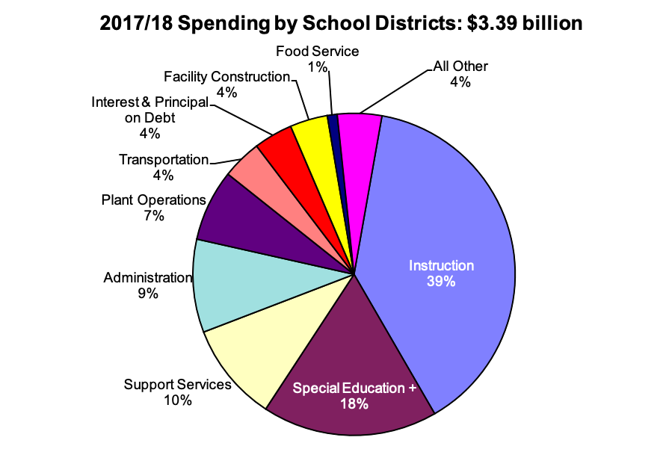

Slide 42
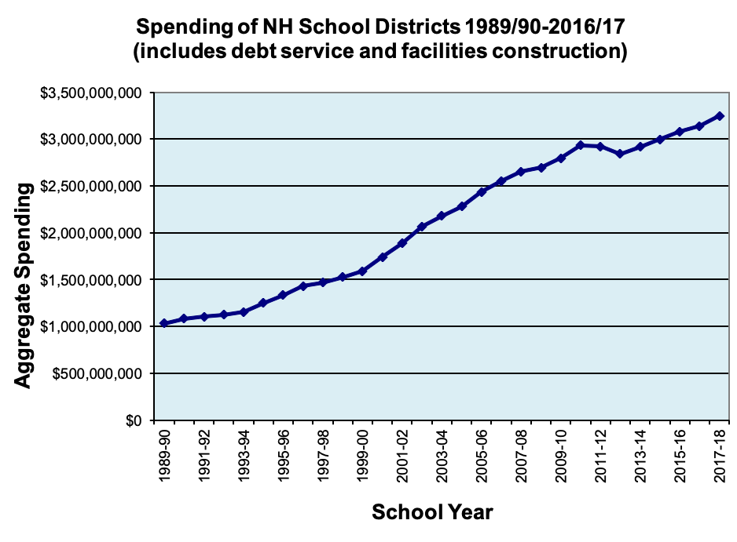

Slide 43
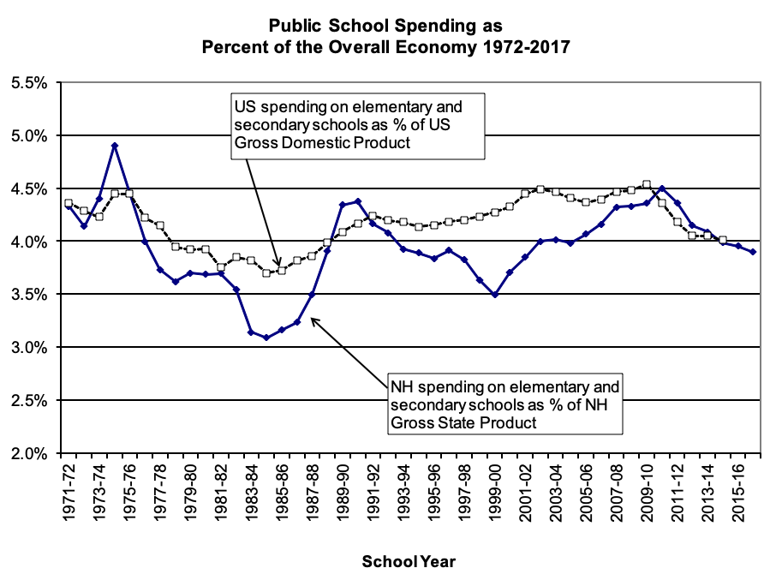

Slide 44
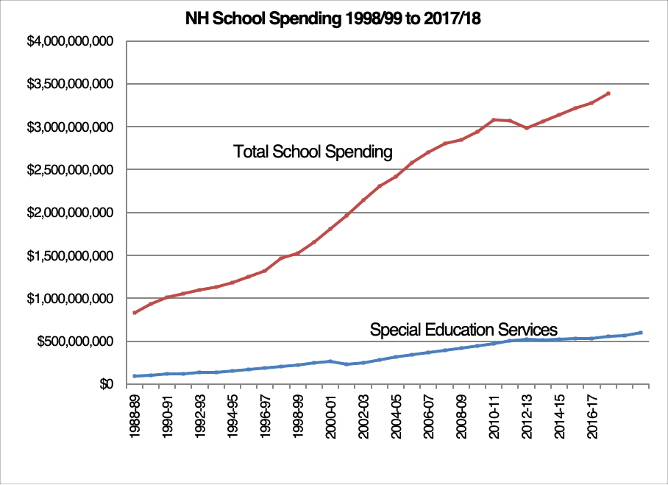

Slide 45
